Slide 1
Research Progress Report by:
Soufiane CHAMI
Biomedical Engineering Research Complex (BERC) Laboratory
Estimated hours spent on activities related to:
Research: X hours
Courses: X hours
Others: X hours
From: DD/MM/YY
To: DD/MM/YY
Sepsis Challenge

Slide 2
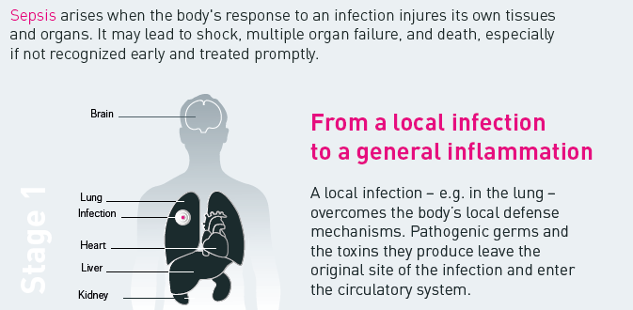
2. What is Sepsis
Stage 1
Source: world-sepsis-day.org

Slide 3
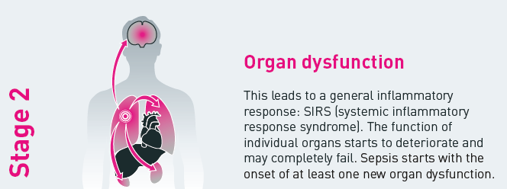
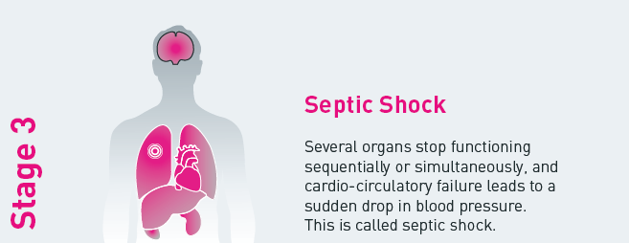
2. What is Sepsis
Source: world-sepsis-day.org

Slide 4
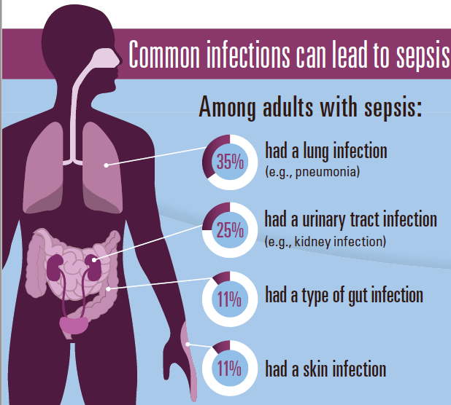
2. What is Spesis

Slide 5
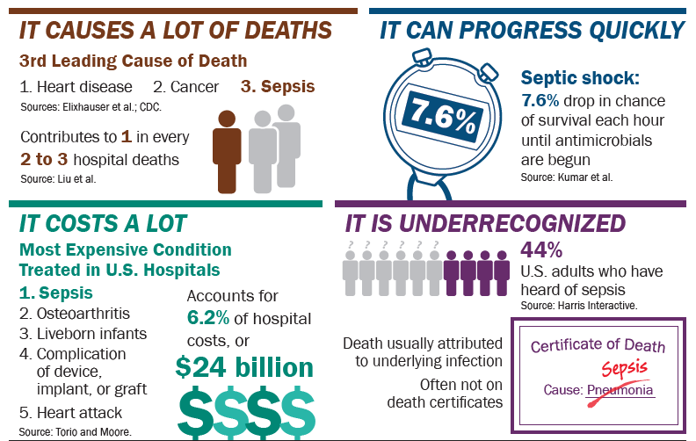
2. What is Sepsis

Slide 6
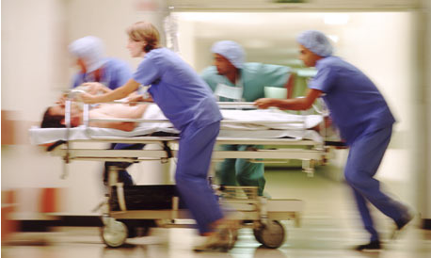
Sepsis is a medical emergency . . .
Mortality rates increase as the number of failing organs increase.
Every hour a patient in septic shock doesn't receive antibiotics,
the risk of death increases by 7.6%.
Source: Colorado Hospital Association

Slide 7

Keys to Survival
Early Identification
  Subtle signs and symptoms
  Don’t wait until your patient is hypotensive!
  Appropriate antibiotics in a timely manner
  For every hour antibiotics are delayed during septic shock, the patient’s risk of death increases by 7.6%
  The single most important intervention in treating sepsis

Slide 8
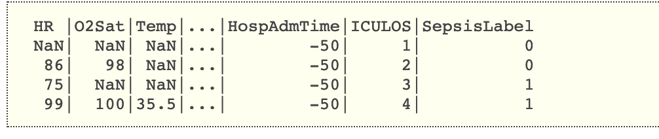
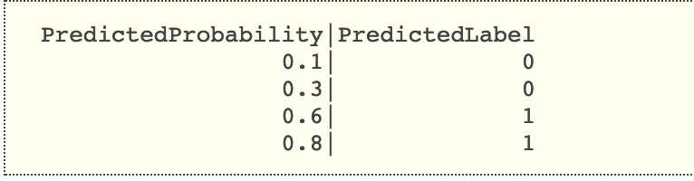
Physio-Net Data
Table of 40 columns for each patient.
Resolution: one point per hour
Output:

Slide 9
Some promising columns
Previous research state that for HR and BP are great indicator for Sepsis BUT for only for Data with High resolution (20 point per minutes )
HR | Heart rate (beats per minute)
O2Sat | Pulse oximetry (%)
Temp | Temperature (Deg C)
SBP | Systolic BP (mm Hg)
MAP | Mean arterial pressure (mm Hg)
DBP | Diastolic BP (mm Hg)
Resp | Respiration rate (breaths per minute)
EtCO2 | End tidal carbon dioxide (mm Hg)

Slide 10
Time to Failure
Two hours till the sepsis take over
Time | Sepsis | Time to Failure
2014-02-11 | Up | 4
2014-02-12 | Up | 3
2014-02-13 | Up | 2
2014-02-14 | Up | 1
2014-02-15 | Down | 0

Slide 11
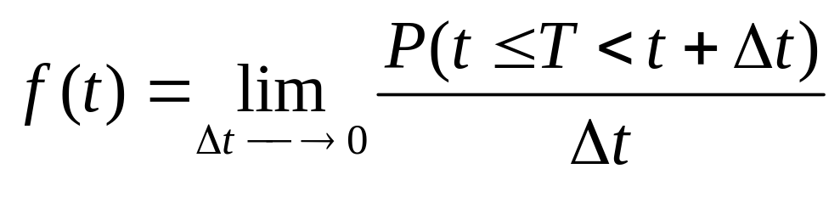
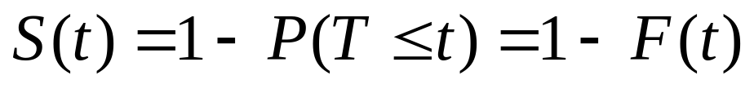
Survival Analysis
Survival Analysis: estimate time to events based on the recent behavior/measurements.
Probability density function: f(t)
Survival function: 1-F(t)
F(t) = CDF of f(t), and is “more interesting” than f(t).

Slide 12
Thank you

